Slide 1

SyrianTel Customer Churn Analysis
(From Data to Retention Strategy)
By Erick Mauti
20 July, 2025

Slide 2

Stopping the Leakage Saves $205K/Year from Customer Churn
1. What is churn?
Customers leaving your service each month.
Example: If 100 customers sign up but 5 leave, you have 5% monthly churn.
2. Why It Matters:
Like a leaky bucket - you keep pouring water (acquiring customers) but lose water (revenue) through holes (churn).
3. Key Impact:
High churn means you're spending more to refill than fixing leaks.
4. Cure:
Like plugging holes in a leaky bucket, our proactive retention model stops $205K in annual revenue from draining.

Slide 3
Problem Statement
SyriaTel is losing revenue due to preventable customer churn. To combat this, we aim to proactively identify at-risk subscribers using behavioral patterns and spending tiers, enabling targeted retention strategies to curb attrition.
Key Business problem question
1. Churn Quantification
What percentage of customers leave monthly, and what revenue does this cost us?
Which customer groups (High/Medium/Low spenders) drive the biggest revenue losses?
Root Causes
What behavioral patterns precede churn (e.g., international plan usage, frequent support calls)?
3. Proactive Prevention
Can we flag at-risk customers at least 30 days before they churn?
What measurable thresholds (e.g., 4+ service calls/month) should automatically trigger retention efforts?
How much revenue could we save by acting on these alerts?

Slide 4
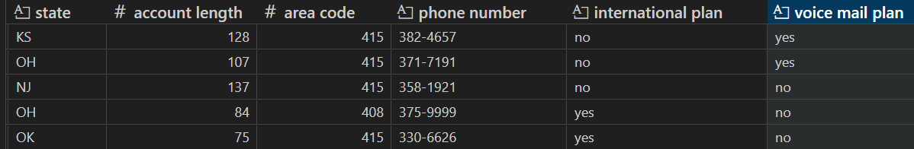
Dataset Overview
Source:
SyriaTel Customer Churn dataset (Kaggle )
Scope:
3,333 customers (records)
21 features covering:
State, phone number, international plan, voice mail plan etc
Snapshot of the dataset
Purpose:
Predict churn to reduce revenue loss ($205k/year attributed to churn).

Slide 5
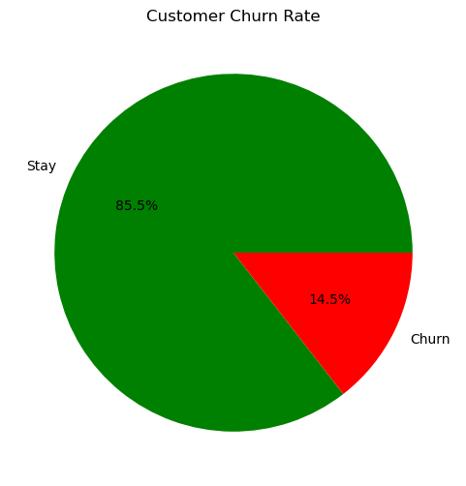
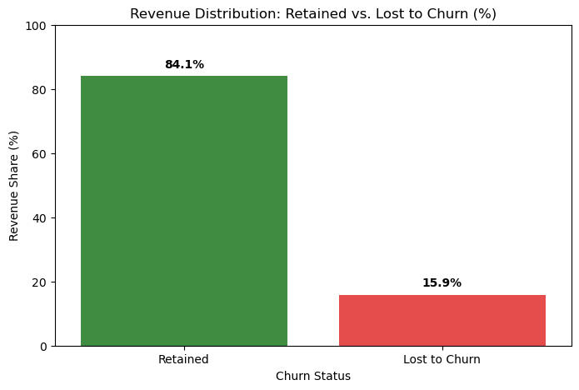
Key Findings
1. Revenue Impact
14.5% Churn = 15.9% Revenue Erosion
The 1.4% difference implies that the organization breeds high valued customers

Slide 6
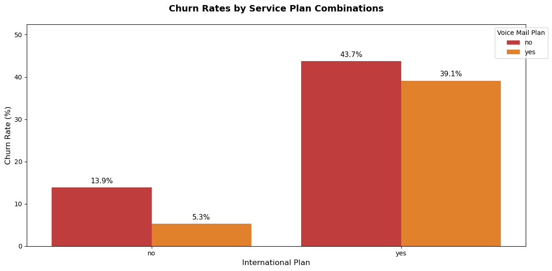
Key Findings
2. High-Risk Plan
The highest risk group is international plan-only customers(43.7% of its customers churn)
Voice mail plan on international calls reduce churn by 10.5%

Slide 7
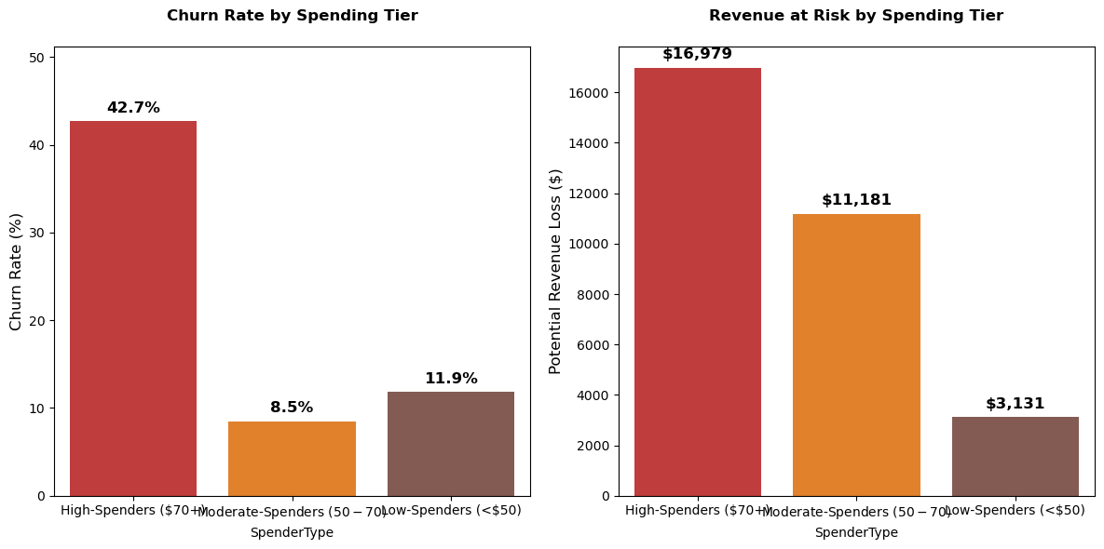
Key Findings
3. Behavioral Insight
High-Spenders ($70+ monthly charges) Churn 5X Faster than moderate spenders
High-Spenders erode 54.3% of lost revenue to churn

Slide 8
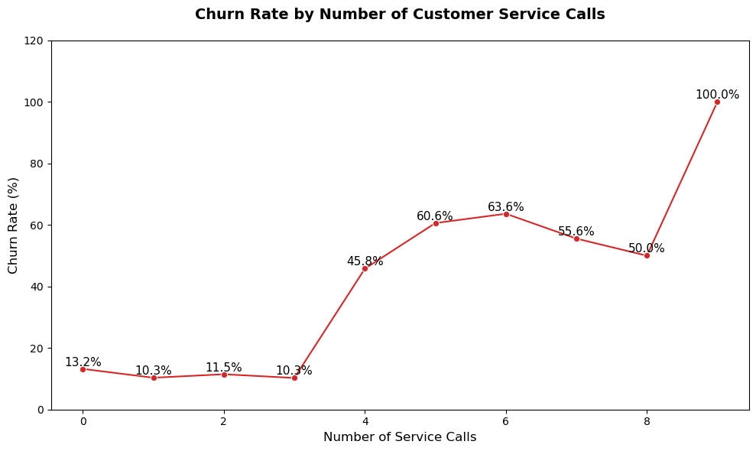
Key Findings
4. Customer Service
Customers who make more than 4 calls have more than 50% churn
Customers with more than 8 calls churn at 100%

Slide 9
Data Preprocessing
Loading data and General inspection:
View features, data type, missing values, duplicates and statistical summary.
2. Cleaning
Transformed features into standard naming(snake casing)
2. Feature Engineering
Created ‘Revenue’ and ‘Spender-type’ columns
Dropped irrelevant columns like phone-number
3. Encoding
One-hot encoding applied to categorical columns
Ordinal encoding on ordinal columns like churn

Slide 10
Model Building
Algorithms Tested:
Logistic regression
Random forest
XGBoost
Evalution metrics:
Recall – Focuses on predicting at-risk customers
Precision – Focuses on reducing false negative
ROC-AUC – Evaluates model performance
Model for deployment
Stratified Random Forest performs well(77%)

Slide 11
Model Performance
Inferences:
The model retained 372 customers out of 483 who churned
Stopped $205K per year revenue loss.
ROI on retention plan is 2.4X. Implies that, in every $1 invested in the model retains $2.4
Amount still at risk $7,239
The model is able to capture 77 out of 100 churning customers
Before Model | Position
Total customers | 3,333
Churned Customers | 483
Total Revenue | 198,146
Churned Revenue | 31,505
Model Projections | Position
Customers Retained | 372
Amount Recovered | 24,266
Cost of Recovery | 7,200
Net Revenue Recovered | 17,066
New look ( After Retention) | Position
Total customers | 3,333
Churned Customers | 108
Total Revenue | 198,146
Churned Revenue | 7,239

Slide 12
Business Recommendation
Immediate Priority: Protect High-Value Revenue (0–30 Days)
A. Target High-Spenders ($70+/Month) – 54% of Lost Revenue
Action: Assign dedicated account managers to high-spenders for proactive support.
Justification: Losing just 50 high-spenders costs a minimum of $3,500/month ($70/churner).
Retention Offer: Personalized discounts (≤$15/customer) to preserve margin.
B. Deploy Random Forest Model (77% Recall)
Action: Automatically flag customers with ≥30% churn risk (0.23 threshold).
Key Triggers:
≥4 service calls/month (top churn predictor).
International plan users (3× higher churn risk).
>40% spending drop (early warning sign).

Slide 13
Business Recommendation
2. Short-Term Fixes: Eliminate Churn Triggers (1–3 Months)
A. Improve Network & Customer Service
Fix Complaints: Audit top 10 high-churn states for network gaps
Competitive Pricing: Benchmark against rivals in high-attrition regions
B. Introduce International Voicemail Plan
Why? International users churn 3× faster than domestic users
Action: Bundle free voicemail to reduce friction

Slide 14
Business Recommendation
3. Long-Term System: Proactive Retention (3–6 Months)
A. Customer Health Dashboard
Real-Time Alerts:
High Risk: Customer X (4+ calls, 65% churn probability)
Spending Drop: Customer Y (45% reduction, investigate)
B. Reduce False Positives
Rule: Only act on 40–70% churn risk (balances recall & cost)
Low-Cost Tactics: Automated emails for 30–40% risk
What Next?
Pilot Phase (Month 1-2)
Target top 20% highest-risk customers
Validate savings with controlled campaigns

Slide 15
Thank you
Q & A

